Slide 1
Third Party Cloud Services: MetaCDN, SpotCloud, Federated Clouds / Inter Cloud
5.1

Slide 2
Third Party Cloud Services
One of the key elements of cloud computing is the possibility of composing services that belong to different vendors or integrating them into existing software systems.
The service-oriented model, which is the basis of cloud computing, facilitates such an approach and provides the opportunity for developing a new class of services that can be called third-party cloud services.

Slide 3
Third Party Cloud Services
These are the result of adding value to preexisting cloud computing services, thus providing customers with a different and more sophisticated service.
Added value can be either created by smartly coordinating existing services or implementing additional features on top of an existing basic service.

Slide 4
Third Party Cloud Services
Some examples of third-party services:-
MetaCDN
SpotCloud

Slide 5
What is a CDN?
A content delivery network (CDN) is a network of interconnected servers that speeds up webpage loading for data-heavy applications.
CDN can stand for content delivery network or content distribution network.
https://aws.amazon.com/what-is/cdn/

Slide 6
What is a CDN?
When a user visits a website, data from that website's server has to travel across the internet to reach the user's computer. If the user is located far from that server, it will take a long time to load a large file, such as a video or website image.
Instead, the website content is stored on CDN servers geographically closer to the users and reaches their computers much faster.
https://aws.amazon.com/what-is/cdn/

Slide 7
Why is a CDN important?
The primary purpose of a content delivery network (CDN) is to reduce latency, or reduce the delay in communication created by a network's design.
Because of the global and complex nature of the internet, communication traffic between websites (servers) and their users (clients) has to move over large physical distances.
The communication is also two-way, with requests going from the client to the server and responses coming back.
https://aws.amazon.com/what-is/cdn/

Slide 8
Why is a CDN important?
A CDN improves efficiency by introducing intermediary servers between the client and the website server.
These CDN servers manage some of the client-server communications. They decrease web traffic to the web server, reduce bandwidth consumption, and improve the user experience of your applications.
https://aws.amazon.com/what-is/cdn/

Slide 9
CDN?
You could think of a CDN like an ATM.
Having a cash machine on practically every corner makes it fast and efficient to get money. There’s no wait time in long bank lines, and the ATMs are placed in many convenient locations for immediate access.
https://www.akamai.com/our-thinking/cdn/what-is-a-cdn

Slide 10
CDN?
CDN services were created to solve the problem of network congestion caused by delivering rich web content, such as graphics and video over the internet — much like a traffic jam.
Getting content from centrally located servers to individual users simply took too long.
CDNs have now grown to include everything from text, graphics, scripts, and media files to software downloads, documents, portals, ecommerce, live streaming media, on-demand video streaming media, and social media sites.
https://www.akamai.com/our-thinking/cdn/what-is-a-cdn

Slide 11
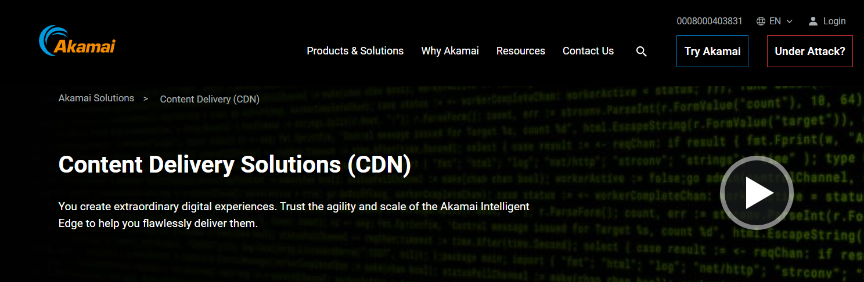
Existing CDN providers
Akamai is the clear leader in coverage and market share (approx. 80%)
Price is prohibitive for SME, NGO, Gov...
• Academic CDNs include Coral, Codeen, Globule....

Slide 12
MetaCDN
MetaCDN provides users with a Content Delivery Network (CDN).
It implements a software overlay that coordinates the service offerings of different cloud storage vendors and uses them as distributed elastic storage on which the user content is stored.

Slide 13
MetaCDN enables the uniform use of heterogeneous storage clouds as a single, large, distributed content delivery network.
The advantage is not only given by providing a CDN service at accessible costs but also in enriching the original service offering of existing cloud services with additional functionalities,

Slide 14
MetaCDN provides users with the high-level services of a CDN for content distribution and interacts with the low-level interfaces of storage clouds to optimally place the user content in accordance with the expected geography of its demand.

Slide 15
MetaCDN is a pioneering "4th generation" content delivery network (CDN) provider. Our patent pending approach leverages Tier-1 Cloud Storage & CDN suppliers such as Amazon, Microsoft and Google to offer enterprise-class content delivery, video encoding and streaming services on an unmatched global scale.
http://www.metacdn.com/aboutus

Slide 16

Founded in 2011 from research out of the University of Melbourne,
MetaCDN is backed by leading Australian venture capital firm Starfish Ventures and the University of Melbourne's commercialisation arm
http://www.metacdn.com/aboutus

Slide 17
What if we could create a low-cost, high performance overlay CDN using heterogenous storage clouds?
Exploit the strengths and coverage footprints of multiple providers
Cherry pick providers based on customers QoS needs / cost budget
MetaCDN provides this while hiding the complexity from users

Slide 18
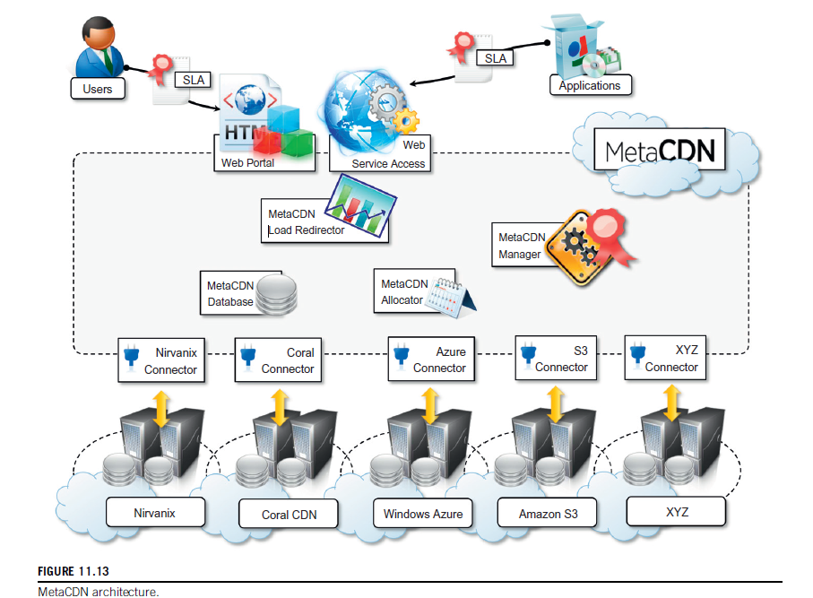
MetaCDN Architecture

Slide 19
MetaCDN Architecture
The MetaCDN interface exposes its services through users and applications through the Web;
users interact with a portal,
while applications take advantage of the Web services.

Slide 20
MetaCDN Architecture
The portal constitutes a more intuitive interface for users with basic requirements,
The Web service provides access to the full capabilities of MetaCDN and allows for more complex and sophisticated deployment.

Slide 21
MetaCDN Architecture
The main operations of MetaCDN are the creation of deployments over storage clouds and their management

Slide 22
MetaCDN deployment options
In particular, four different deployment options can be selected:
Coverage and performance-optimized deployment.
Direct deployment.
Cost-optimized deployment.
QoS optimized deployment.

Slide 23
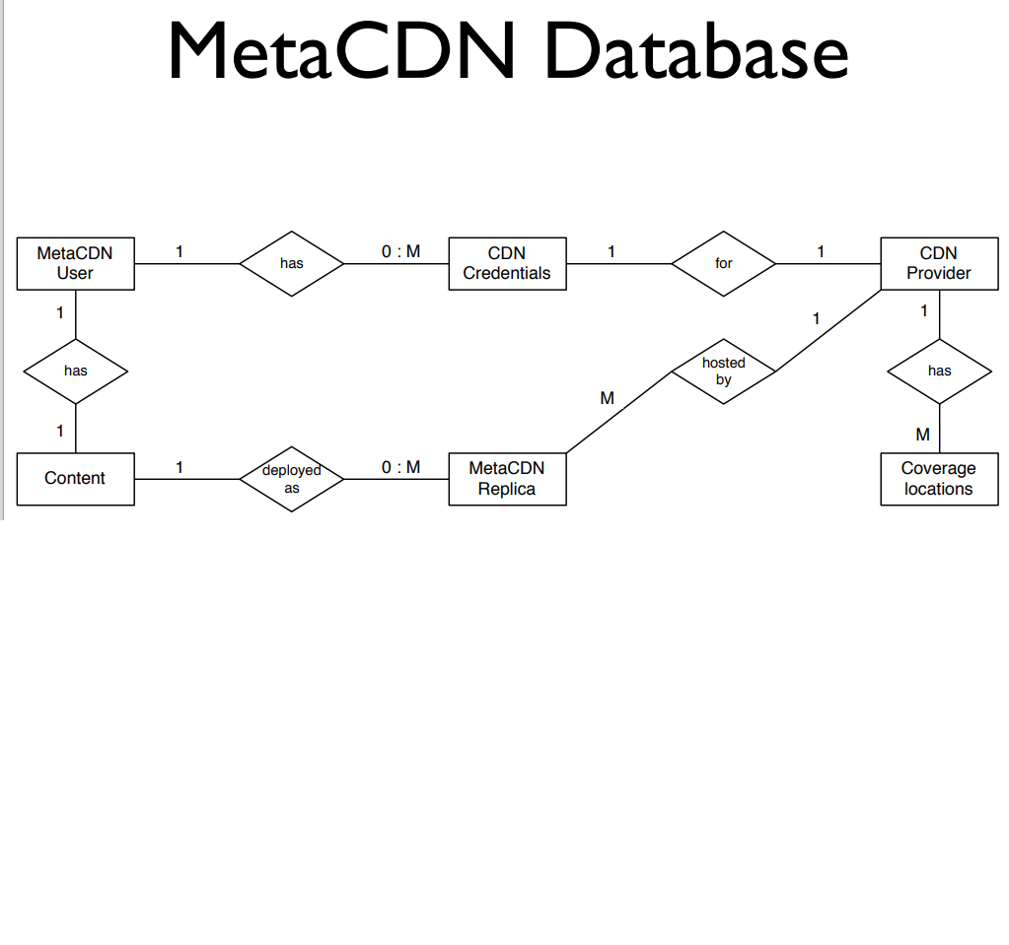

Slide 24
MetaCDN deployment options
In particular, four different deployment options can be selected:
Coverage and performance-optimized deployment-
In this case MetaCDN will deploy as many replicas as possible to all available locations.
Direct deployment-
In this case MetaCDN allows the selection of the deployment regions for the content and will match the selected regions with the supported providers serving those areas.

Slide 25
MetaCDN deployment options
Cost-optimized deployment-
In this case MetaCDN deploys as many replicas in the locations identified by the deployment request. The available storage transfer allowance and budget will be used to deploy the replicas and keep them active for as long as possible.
QoS optimized deployment-
In this case MetaCDN selects the providers that can better match The QoS requirements attached to the deployment, such as average response time and throughput from a particular location.

Slide 26
MetaCDN components
Of particular importance are three components:
the MetaCDN Manager,
the MetaCDN QoS Monitor, and
the Load Redirector.

Slide 27
MetaCDN components
The Manager is responsible for ensuring that all the content deployments are meeting the expected QoS.
Manager is supported in this Activity by the Monitor, which constantly probes storage providers and monitors data transfers to assess the performance of each provider.

Slide 28
MetaCDN components
Content serving is controlled by the Load Redirector, Which is in-charge of redirecting user content requests to the most suitable replica given the condition of the systems and the options specified during the deployment.

Slide 29
MetaCDN components
Interactions with storage clouds are managed by means of connectors, which abstract away the different interfaces exposed by the providers and present a uniform interface within the MetaCDN system.

Slide 30
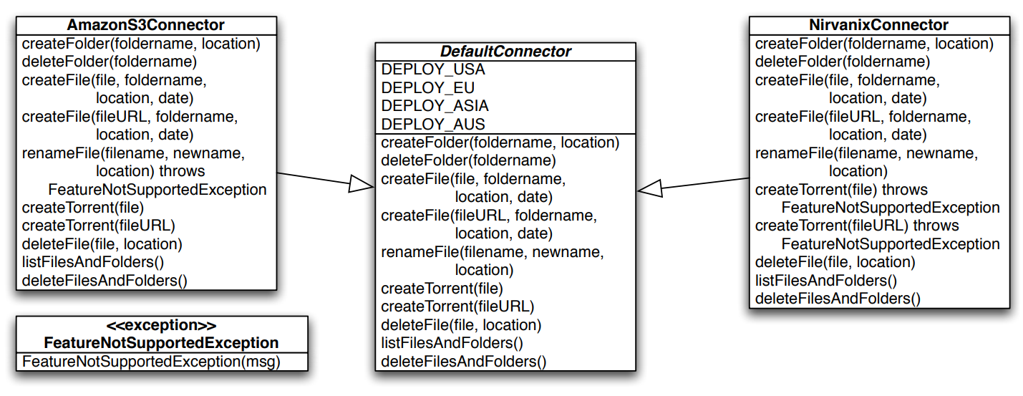
How MetaCDN works

Slide 31
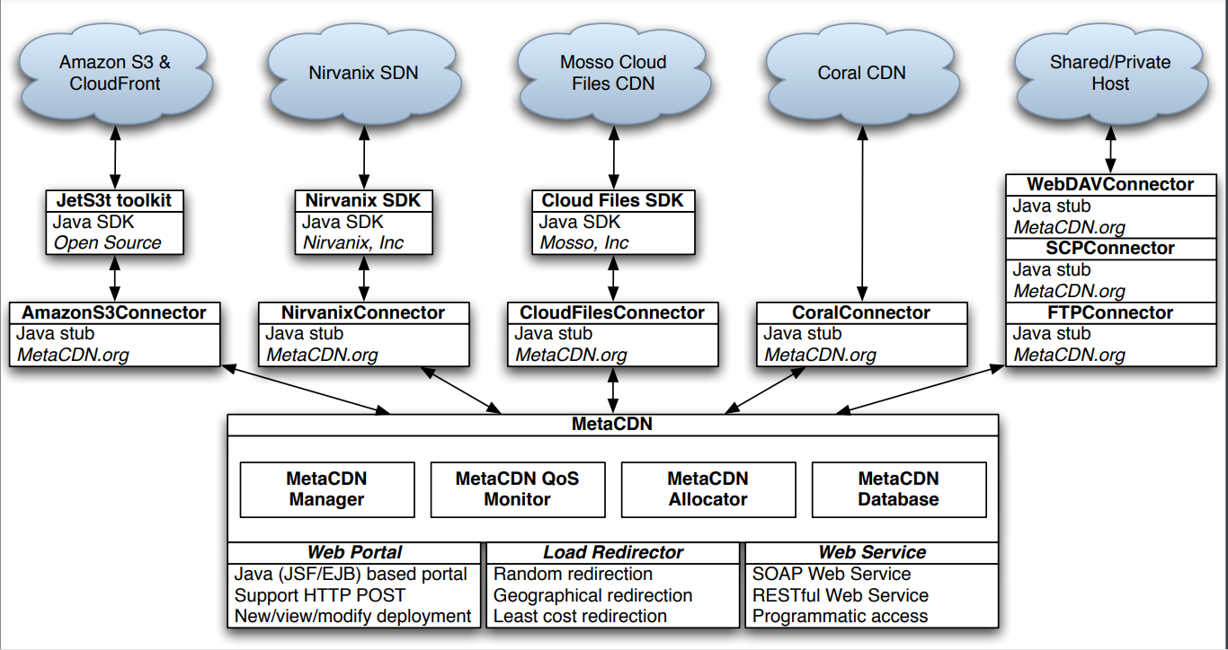
How MetaCDN works

Slide 32
SpotCloud
SpotCloud is an online portal that implements a virtual marketplace, where sellers and buyers can register and trade cloud computing services.
The platform is a market place operating in the IaaS sector.
Buyers are looking for compute capacity that can meet the requirements of their applications, while sellers can make available their infrastructure to serve buyers

Slide 33
SpotCloud
SpotCloud provides a comprehensive set of features that are expected for a virtual marketplace.
Some of them include:
Detailed logging of all the buyers’ transactions
Full metering, billing for any capacity
Full control over pricing and availability of capacity in the market
Management of quotas and utilization levels for providers
Federation management (many providers, many customers, but one platform)
Hybrid cloud support (internal and external resource management)
Full market administration and reporting
Applications and pre-build appliances directories

Slide 34
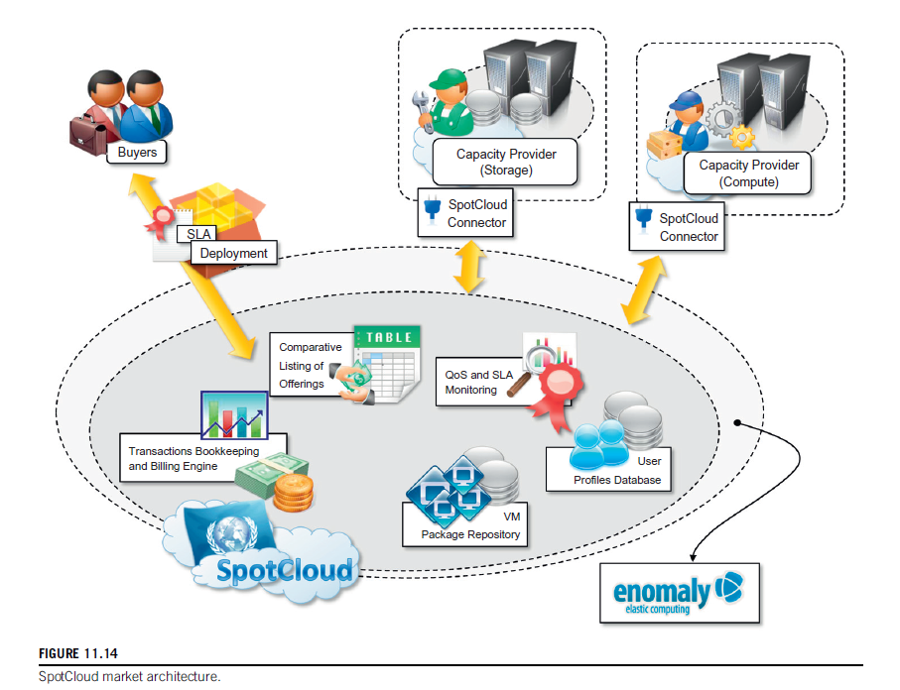
SpotCloud
By acting as an intermediary for trading compute and storage between consumers and service providers, it provides the two parties with added value.

Slide 35
SpotCloud
In addition, it allows users with available computing capacity to easily turn themselves into service providers by deploying the runtime environment required by SpotCloud on their infrastructure

Slide 36
SpotCloud
For service consumers, it acts as a market directory where they can browse and compare different IaaS service offerings and select the most appropriate solution for them.
For service providers it constitutes an opportunity for advertising their offerings.

Slide 37
SpotCloud, the First Clearinghouse at Marketplace for Cloud Computing Services, Launched by Enomaly
??

Slide 38
Spotcloud
For cloud service providers, the SpotCloud marketplace platform provides an easy way to sell unused cloud capacity.
Cloud providers can use SpotCloud to clear out unused capacity and sell computing inventory that would otherwise go unsold, enabling increased utilization and revenue, without undermining their standard pricing.

Slide 39
SpotCloud
SpotCloud is not only an enabler for IaaS providers and resellers,
Also includes a complete bookkeeping of the transactions associated with the use of resources.

Slide 40
SpotCloud
Users deposit credit on their SpotCloud account and capacity sellers are paid following the usual pay- per-use model.
SpotCloud retains a percentage of the amount billed to the user.

Slide 41
SpotCloud
Moreover, by leveraging a uniform runtime environment and virtual machine management layer, it provides users with a vendor lock-in-free solution, which might be strategic for specific applications.

Slide 42
Federated Clouds/Intercloud
These are enablers for MOCC since they provide means for interoperation among different cloud providers.
Building aggregations of clouds that belong to different administrative domains.

Slide 43
Federated Clouds
Federation
Creation of an organization that supersedes the decisional and administrative power of the single entities and that acts as a whole.
Within a cloud computing context, the word federation implies that there are agreements between the various cloud providers, allowing them to leverage each other’s services in a privileged manner.

Slide 44
Federated Clouds
Definition:-
“Cloud federation manages consistency and access controls when two or more independent geographically distinct Clouds share either authentication, files, computing resources, command and control or access to storage resources”
-By Reuven Cohen, founder and CTO of Enomaly Inc.

Slide 45
Technologies for cloud federations
Even though the concept of cloud federation or the InterCloud is still immature, there are some supporting technologies that enable the deployment of interoperable clouds:-
RESERVOIR

Slide 46
RESERVOIR
Resources and Services Virtualization Without Barriers, or RESERVOIR
A European research project focused on developing an architecture that supports providers of cloud infrastructures to dynamically partner with each other to extend their capabilities while preserving their administrative autonomy.

Slide 47
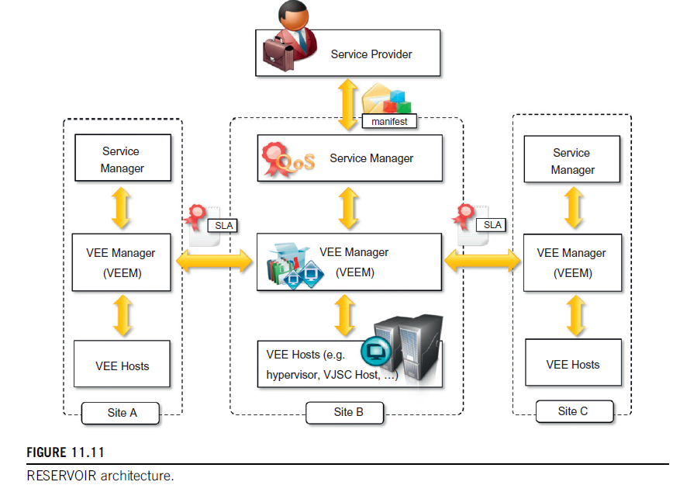
RESERVOIR Architecture

Slide 48
RESERVOIR Architecture
Service Manager –
Constitutes the front-end used by service providers to submit service manifests, negotiate pricing, and monitor applications.
This component deploys and provisions VEEs according to the service manifest and monitors and enforces SLA compliance by controlling the capacity of a service application.

Slide 49
RESERVOIR Architecture
Virtual Execution Environment (VEE) Manager –
Core of the RESERVOIR middleware
is responsible for the optimal placement of VEEs into VEE hosts according to the constraints expressed by the Service Manager.

Slide 50
RESERVOIR Architecture
Virtual Execution Environment (VEE) Manager –
Moreover, the VEE Manager also interacts with VEE Managers in other sites to provision additional instances for the execution of service applications or move VEEs to other sites in case of overload.
This component realizes the cloud federation.

Slide 51
RESERVOIR Architecture
VEE Host(VEEH) –
Interacts with the VEE Manager to put into practice the IT management decisions regarding heterogeneous sets of virtualization platforms.
Ensures networking among VEEs that belong to the same application

Slide 52
RESERVOIR Architecture
VEE Host(VEEH) –
The VEEH encapsulates all platform-specific management that is required to expose the used virtualization technology through a standardized interface to the VEE Manager.

Slide 53
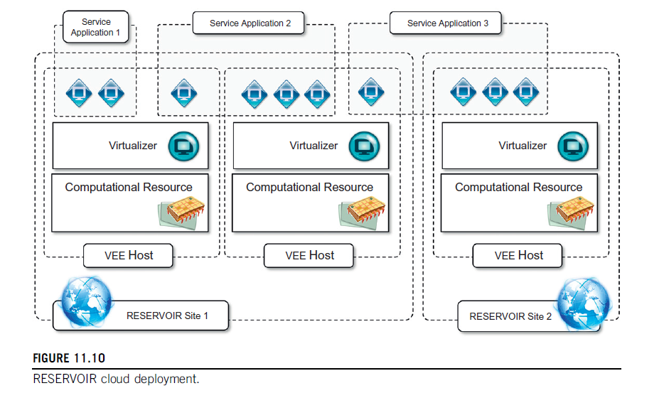
RESERVOIR Cloud deployment
The framework defines an infrastructure overlay that spans multiple administrative domains and different geographic locations.
Each site runs the RESERVOIR software stack

Slide 54
RESERVOIR Cloud deployment
Infrastructure providers operate RESERVOIR sites
Service providers define service applications

Slide 55
RESERVOIR Cloud deployment
In the first case, the service provider conducts sizing to identify the appropriate number of components to be required for a given workload condition.
The specification is obtained by means of minimal service configuration and a set of elasticity rules that are used by RESERVOIR

Slide 56
RESERVOIR Cloud deployment
In the second case, the service provider provides neither a minimal service configuration nor elasticity rules.
The sizing is automatically made by the RESERVOIR middleware, which tries to minimize overprovisioning.

Slide 57
Intercloud
InterCloud is a term that is often used interchangeably to express the concept of Cloud federation.
It was introduced by Cisco for expressing a composition of clouds that are interconnected by means of open standards to provide a universal environment that leverages cloud computing services.

Slide 58
Intercloud
By mimicking the Internet term, often referred as the “network of networks,”
InterCloud represents a “Cloud of Clouds”

Slide 59
Intercloud
Intercloud Expresses the same concept of federating together clouds
In many cases acceptable,
Some practitioners and experts like Ellen Rubin,founder and VP of Products at CloudSwitch— prefer to give different connotations to the two terms:

Slide 60
Intercloud
InterCloud refers mostly to a global vision in which interoperability among different cloud providers is governed by standards, thus creating an open platform where applications can shift workloads and freely compose services from different sources.
On the other hand, the concept of a cloud federation is more general and includes ad hoc aggregations between cloud providers on the basis of private agreements and proprietary interfaces.

Slide 61
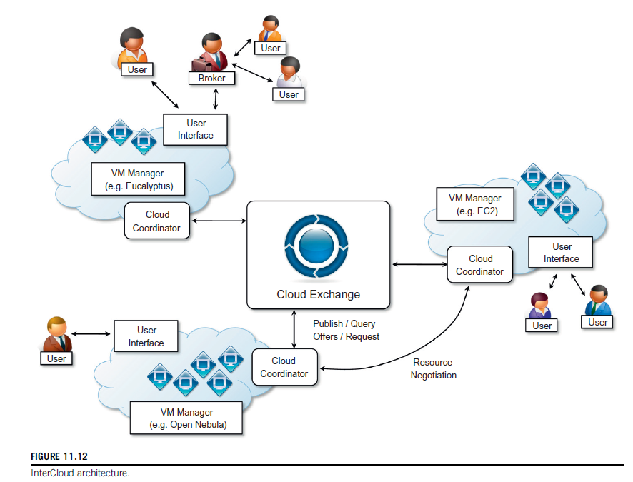
InterCloud Architecture

Slide 62
InterCloud Architecture
InterCloud is a service-oriented architectural framework for cloud federation that supports utility-driven interconnection of clouds

Slide 63
InterCloud Architecture
The InterCloud model comprises two main elements:
CloudExchange
CloudCoordinator

Slide 64
InterCloud Architecture
CloudExchange
This is the market-making component of the architecture.
It offers services that allow providers to find each other in order to directly trade cloud assets, as well as allowing parties to register and run auctions.

Slide 65
InterCloud Architecture
CloudExchange
In the former case, CloudExchange acts as a directory service for the federation.
In the latter case, it runs the auction.

Slide 66
InterCloud Architecture
CloudExchange
CloudCoordinator has
Front-end components (i.e., elements that interact with the federation)
Back-end components (i.e., components that interact with the associated datacenter).

Slide 67
InterCloud Architecture
CloudExchange
Front-end components interact with the CloudExchange and with other coordinators.
Allows datacenters to announce their offers and requirements

Slide 68
InterCloud Architecture
CloudExchange
Back-end components allows the Coordinator to learn about the current state of the datacenter to decide whether actions from the federation are required or not.

Slide 69
InterCloud Architecture
CloudExchange
Wherever the Coordinator detects that extra resources are required by the datacenter,
it triggers the process of discovery of potential providers (by interacting with the cloud federation).
Once potential providers are discovered and the preferred one is selected, the Coordinator contacts the remote Coordinator and negotiates

Slide 70
InterCloud Architecture
CloudExchange
Similarly, when the Coordinator detects that local resources are underutilized,
They can publish an offer for resources in the CloudExchange or they can look for matches among requirements registered in the Exchange service.

